Slide 1
welcome

Slide 2

Kalaingar karunanidhi arts college for women (aut)
PUDUKKOTTAI.
TEAM LEADER
R.Keerthana.
TEAM MEMBERS
R.Kayalvizhi.
S.Keerthana.
T.Kirithika.

Slide 3
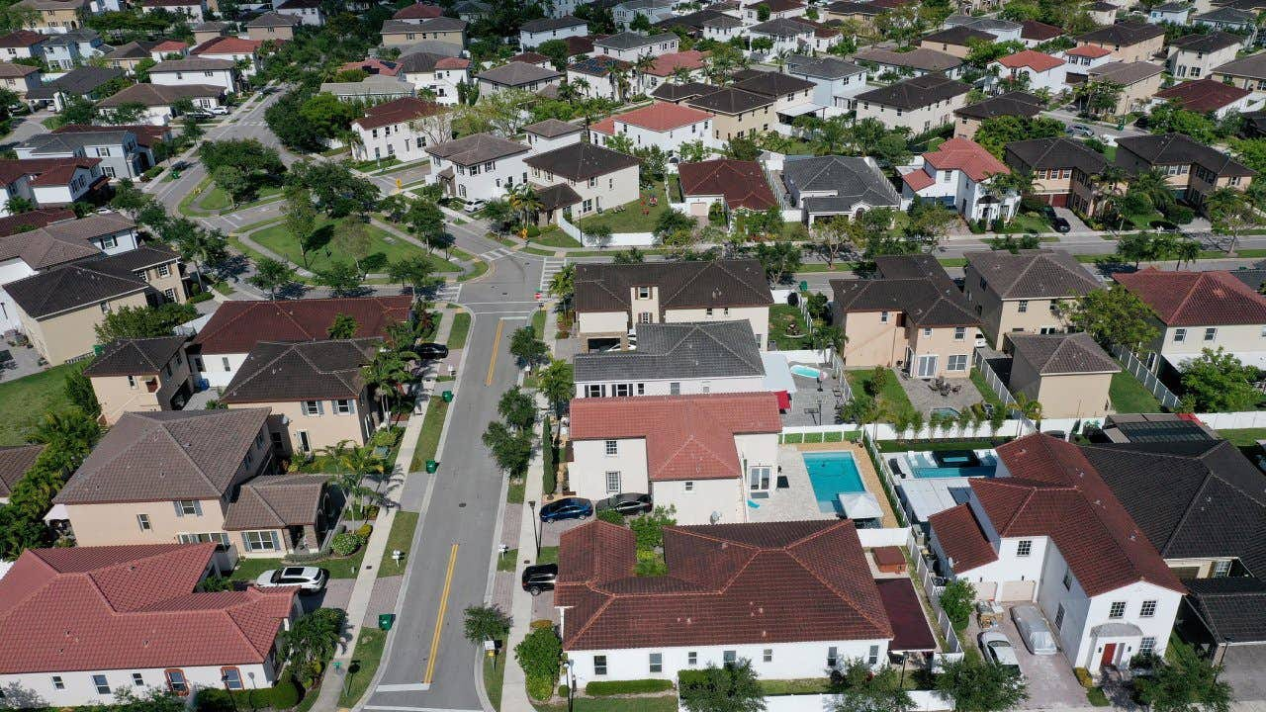
ANALYSING HOUSING PRICES IN METROPOLITAN AREAS OF INDIA

Slide 4
Project report template
1 introduction
1.1 Overview
In India, more specifically, on the study of fifteen metropolitan cities located at different parts of the country consisting Delhi, Mumbai, Bangalore, Kolkata, Chennai, and Hyderabad. Due to their locations, the cities are having regional characteristics Purpose. This disparity in development, like many other indicators, has also been reflected in India. Traditional development theories believed that agriculture, industrialization , urbanization , are significant ingredients of growth, and, ultimately important prerequisites for achieving development. Thus, house price behaviour may also reflect some short of developmental status of the households of a country.

Slide 5
2.1 PURPOSE
As a macro-economic indicator of economic growth ;
As an input into estimating the value of housing as a component of wealth ;
As a financial stability or soundness indicator to measure risk exposure ;

Slide 6
2 Problem definition & design thinking
2.1 Empathy Map
House price prediction can help the developer determine the selling price of a house and can help the customer to arrange the right time to purchase a house.
One such application is predicting house price using linear regression for real estate.
Behavioral attitudes are attitudes that develop as a direct result of certain behavior .

Slide 7
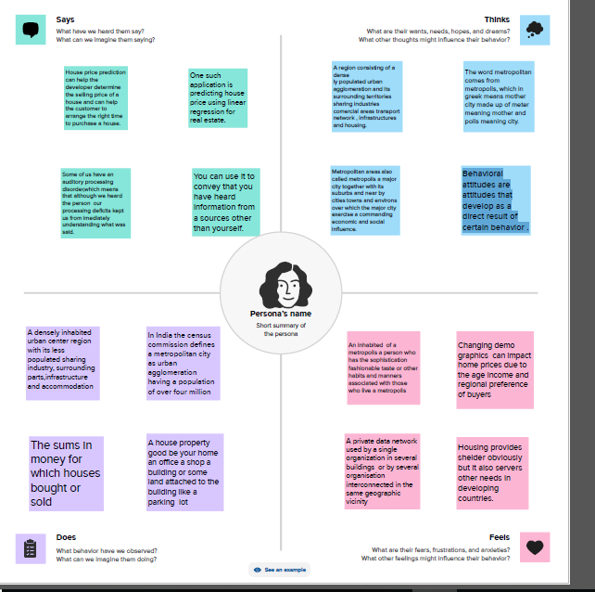

Slide 8
2.2 Ideation & Brainstorming Map
If house prices in one location impose a commutative constraint on house prices in other Location.
The paper concentrats on the prices of residential properties which has been taken from the National Housing Bank in form of index.
The Law of One Prices does not holding Indian housing market case.

Slide 9
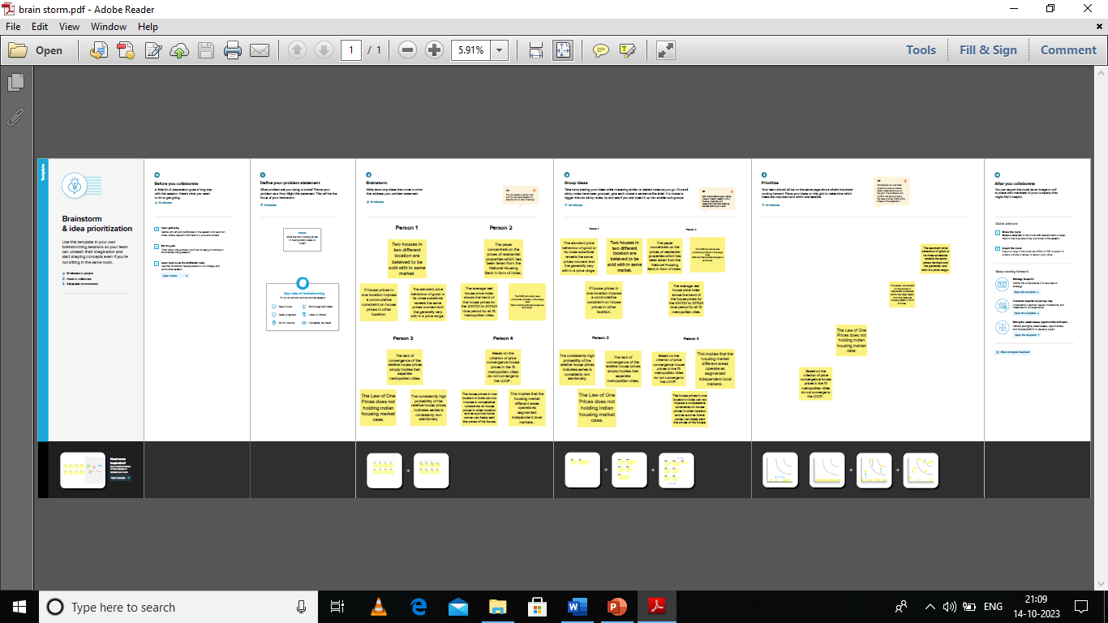

Slide 10
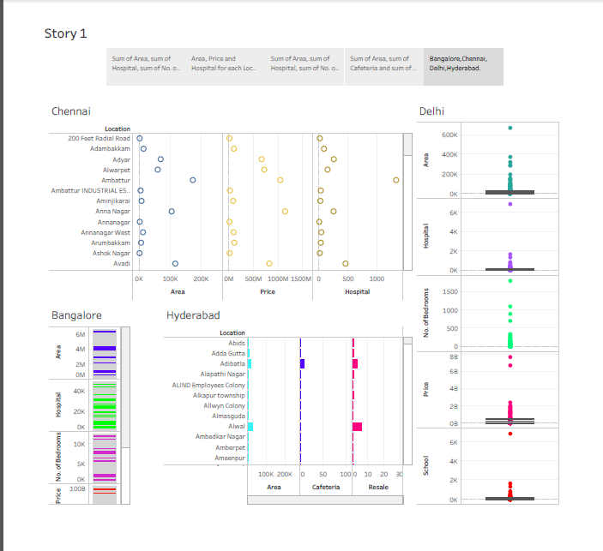
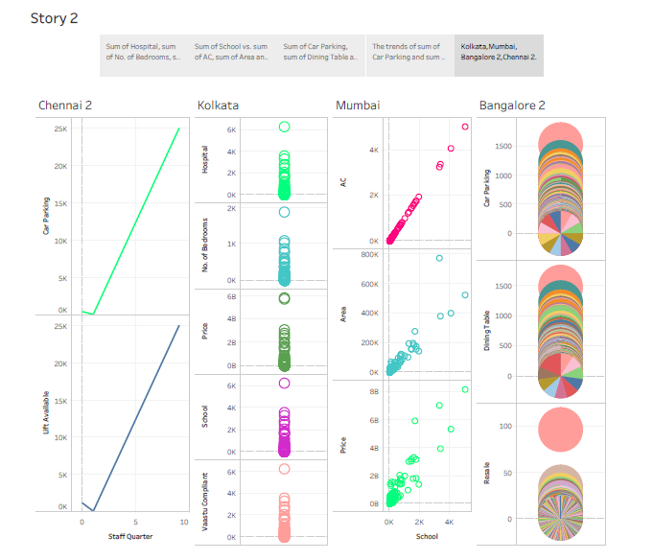
3 RESULT
Story 1 Story 2

Slide 11
4 ADVANTAGES & DISADVANTAGES
DISADVANTAGES
High cost of rent and food.
Overpopulation and pollution.
More inorganic lifestyle.
ADVANTAGES
High-speed internet access in the form of Fiber and 5G.
Head Offices of institutions, banks, boards, etc. are located.
Presence of an International Airport.

Slide 12
5 APPLICATIONS
A similar upward trend is noted in city-specific indices, with property prices in Mumbai, Delhi NCR, and Bengaluru witnessing an impressive rise between 6 to 15%.
The Indian real estate market is showing robust performance in the second quarter of 2023, with sales maintaining its momentum as new supply continues to pour in.

Slide 13
6 CONCLUSION
Bombay is the only city in the country that has a major program of repairs and reconstruction.
Many of the problem associated with the public agency based repairs and reconstruction programme are of finances.

Slide 14
7 FUTURE SCOPE
Real estate is one the fastest growing sectors in india . Hence investing in real estate is one of the most surefire waves to build wealth . The future of real estate is bright in india.
Hence in 2025 the estate sector is likely to set new sale records.

Slide 15
8 apendix my project link
Data Set Link : EXCEL
https://drive.google.com/file/d/1BjFhPEc220lp51LVCxJuePZN5myMIKUc/view?usp=drive_link
https://drive.google.com/file/d/1HLWbZVC104l_9jVwvIF0aoXzrU18O__W/view?usp=drive_link
https://drive.google.com/file/d/1Y8mjTXqzJQ1T4CQZygnYbZ0wRIDEtCIw/view?usp=drive_link

Slide 16
https://drive.google.com/file/d/1NO7cCzQ825hu0L3u0CkZeIQHgKXdfS0C/view?usp=drive_link
https://drive.google.com/file/d/1aos1a87XYFxcroWrHeqW1yGiP-iSPUfl/view?usp=drive_link
https://drive.google.com/file/d/1obopWU2svrsfTEC8s5Jc3Ut4QycxI85Z/view?usp=drive_linkD
TABLEAU
https://github.com/23keerthana/Analysing_Housing_Prices_in_Metropolitan_Areas_of_India_NM2023TMID25629/upload/main

Slide 17
THANK YOU

